Slide 1


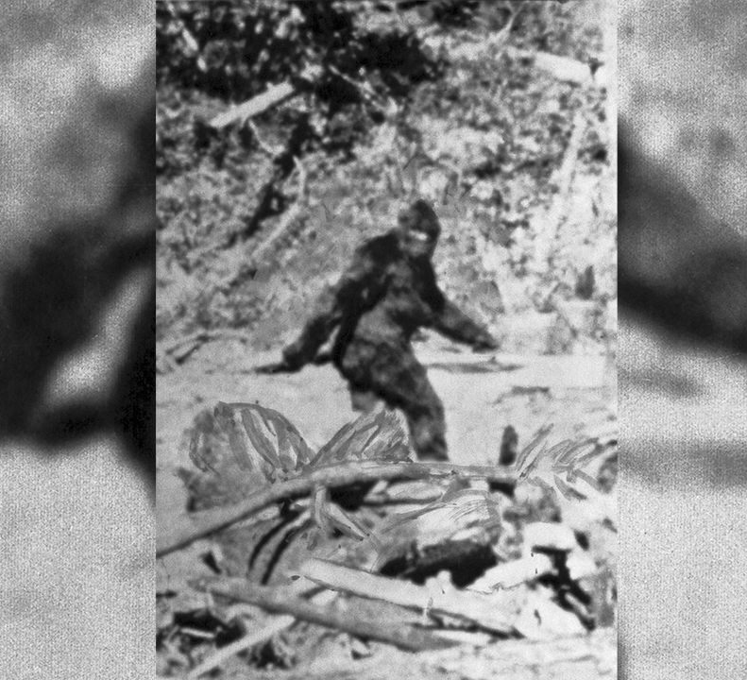

Finding Bigfoot
Analysis by
Katie Briggs
Notes:
NOTE:
To change the image on this slide, select the picture and delete it. Then click the Pictures icon in the placeholder to insert your own image.

Slide 2
Travel Channel’s Expedition Bigfoot
Elite Team that consists of:
Biologist – Emphasis on Primates.
Bigfoot Research Organization member.
Ex-Military and Survivalist.
Claims to use an advanced data algorithm to help pinpoint Bigfoot’s location.
Has 17 days within a distinct radius to gather scientific evidence of Bigfoot’s existence.

Slide 3
Background
The Bigfoot Field Researchers Organization (BFRO) has a website that allows witnesses to enter in Bigfoot sightings/encounters.
The Comprehensive Sightings Database collects data about the sighting:
Season
State or Location
Classification of encounter.
Class A – Credible source and no mistaken identity of other animals.
Class B – Sighting had great distance or was in poor conditions.
Class C – Second to third hand reports that has possibility to be inaccurate.

Slide 4
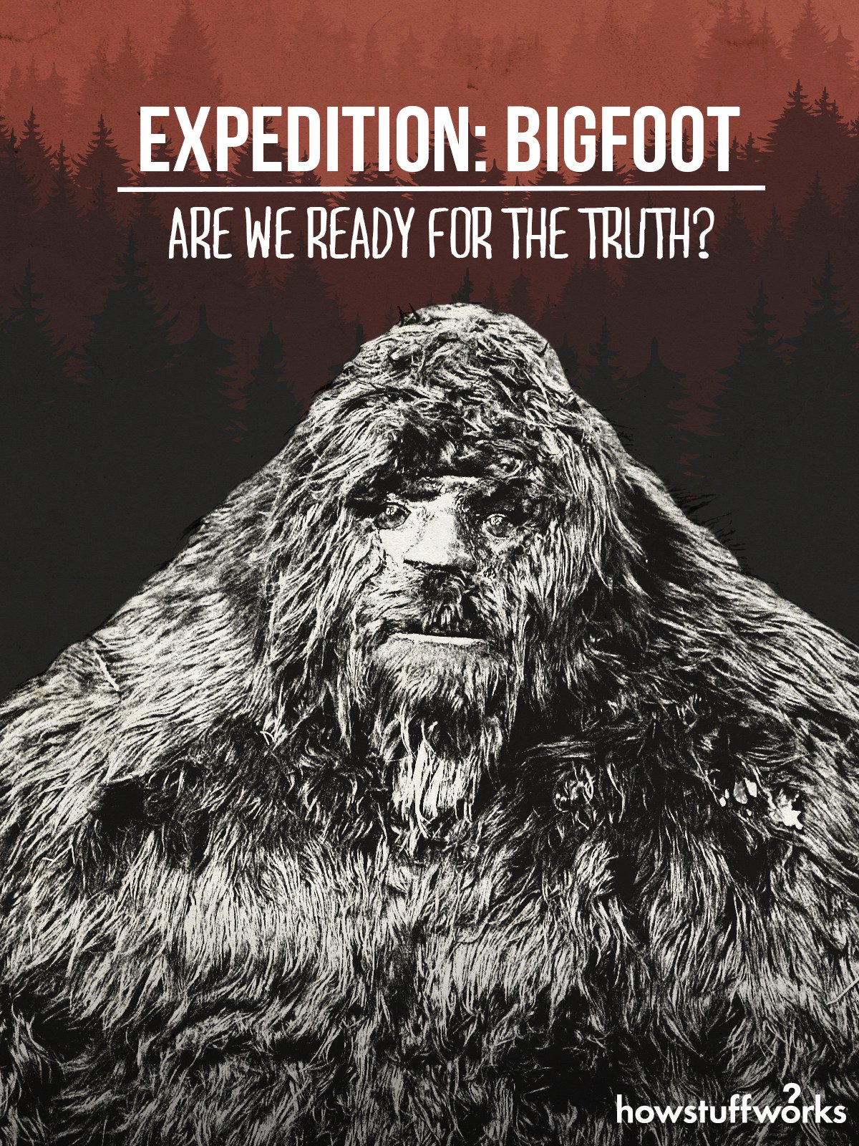
Reason for Analysis
The television show states that, “The researchers use tech tools to analyze five decades of Bigfoot sightings. With this data, they try to pinpoint when and where to encounter this mysterious beast.”
The host and podcaster, Bryce Johnson also claims "What sets us a part is we used a completed algorithm that tells us where Bigfoot is going to be -- and when is going to be there, which gave us a tremendous advantage."

Slide 5

Data Preparation and Exploratory Analysis
Data
Used Python and R Programming Language
Data.World dataset
Bfro_report_locations.csv, Rows = 3995, Columns = 6
Bfro_reports_geocoded.csv, Rows = 4748, Columns = 28
Variables
Bfro_report_locations.csv = Timestamp, Classification, Latitude and Longitude.
Bfro_reports_geocoded.csv = Season, State, Precip_Type and Moon_phase.
Relationships
Looked at relationships between seasons and Precip_Type
Also, looked at relationship of sighting and Moon_Phases

Slide 6
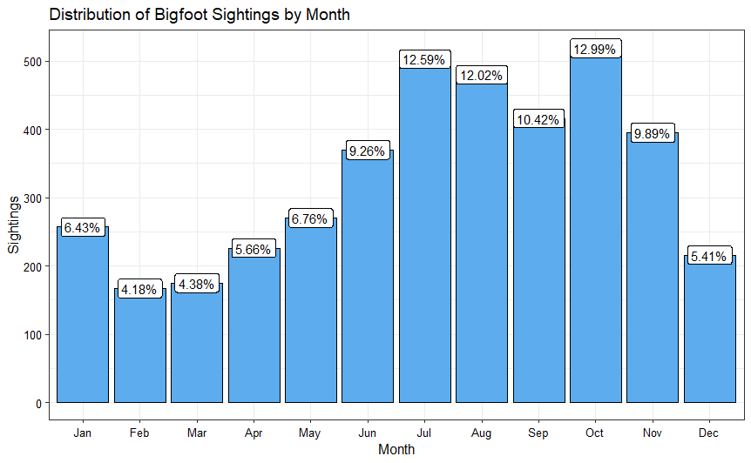
Exploratory Data Analysis Results
Almost half of the reported sightings occurred during the summer and fall seasons.
Top 5 States with Sightings:
Washington
California
Florida
Ohio
Oregon

Slide 7
leaderCluster Model using R
Haversine with lat/lon pairs
with a 175 mile radius
set.seed(31232)
BF.cluster<-leaderCluster(bigfoot.date[,5:6],radius = 175,distance = "haversine",max_iter =25)
Clust.BF<-cbind(ClusterID=BF.cluster$cluster_id,bigfoot.date)
Clust.AGG<-Clust.BF %>% group_by(ClusterID) %>% summarise(Count=n()) %>% mutate(percent.sight=Count/3810) %>% arrange(desc(Count))
Top.5.Clust<-head(Clust.AGG,5)
leaderCluster takes a matrix of coordinates and outputs cluster ids from running the leader algorithm. The coordinates can either be on points in the space R^n, or latitude/longitude pairs. A radius delta must be provided.
leaderCluster(points, radius, weights = rep(1, nrow(points)), max_iter = 10L, distance = c("Lp", "L1", "L2", "Linf", "haversine"), p = 2)

Slide 8
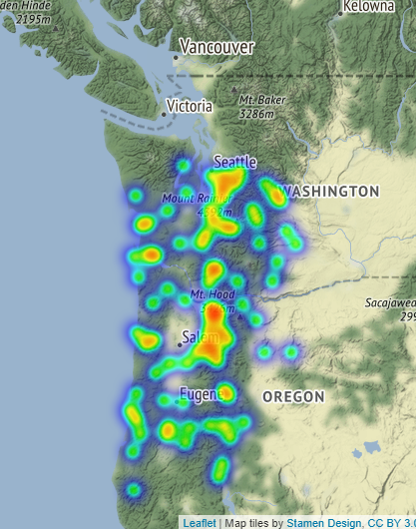
Results
The Most Recorded Sightings
Over 11% percentage of sightings/encounters with Bigfoot happen within western Washington and north Oregon area.
The first Season of Expedition Bigfoot was the team investigating the area between Salem and Eugene.

Slide 9
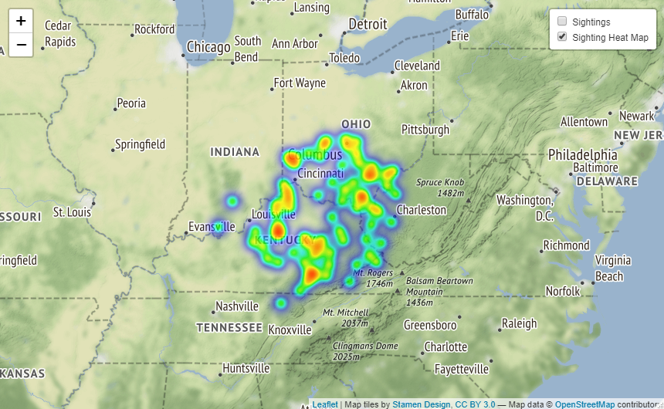
Results
The 5th Most Recorded Sightings
Eastern Kentucky & Ohio Valley
Over 4.4% percentage of sightings/encounters with Bigfoot happen within eastern Kentucky and the Ohio Valley.
The second Season of Expedition Bigfoot was the team investigating the area between Whitesburg and Harlan during the summer.
The famous “Ohio Howl” was recorded in this area in 1994 on the river border of Ohio and West Virginia.

Slide 10
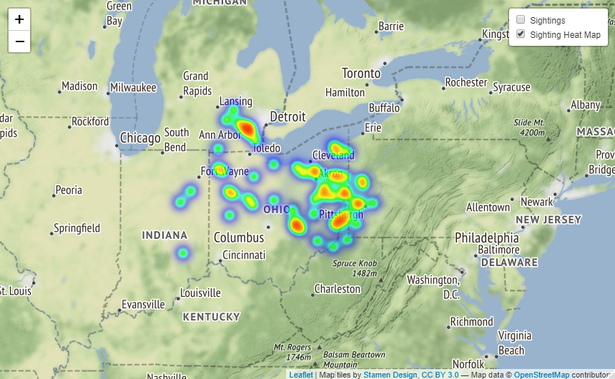
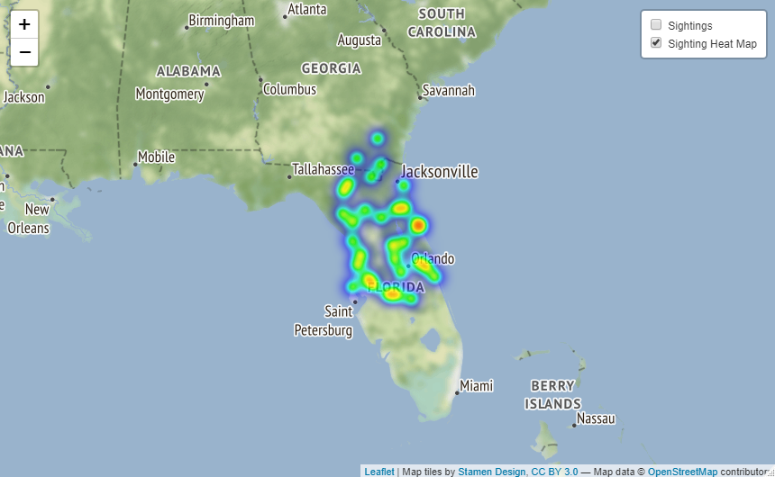
Results
2nd Highest
3rd Highest

Slide 11
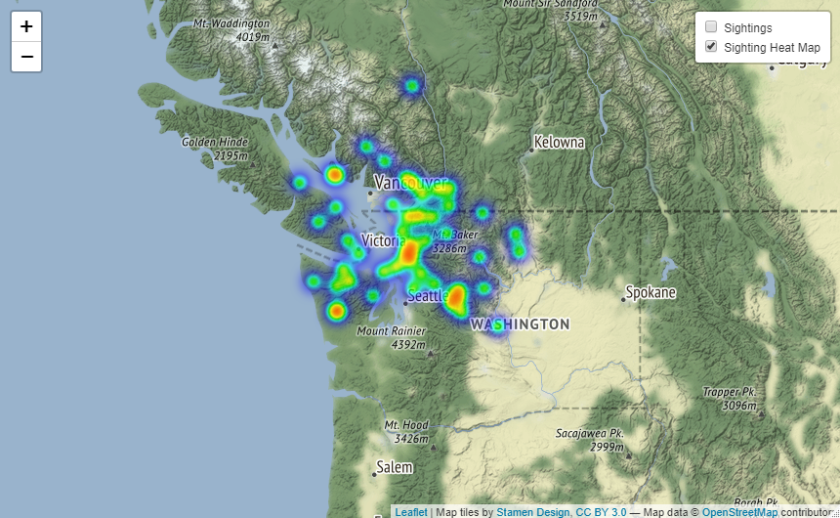
Results
^{4th} Highest Sightings
In Washington Peninsula and border of Canada.
In the second season, the team also traveled to and investigated this area for evidence.

Slide 12
Conclusion
A clustering algorithm can help pinpoint the hot spot locations of reported sightings and the chance to get a glimpse of this elusive creature.
Acknowledgements
Travel Channel and Expedition Bigfoot
BFRO
Bellevue University
Professor Williams

Slide 13
References
Full text and Geocoded dataset from The Bigfoot Field Research Organization (BFRO), data.word, with three files, brfo_report_locations.csv, bfro_reports.json, and bfro_reports_gecoded.csv. https://data.world/timothyrenner/bfro-sightings-data
Burton, B., (2020), How Expedition Bigfoot tracks the big beast with drones and algorithms, On Travel Channel’s new show, survivalists, scientists and researchers use the latest high-tech gadgets to look for the elusive Sasquatch. Retrieved from: https://www.cnet.com/news/how-expedition-bigfoot-tracks-the-big-beast-with-drones-and-algorithms/
Dobson, J., (2020), Televised Expedition May Prove The Elusive Beast Is Real, Forbes, Retrieved from: https://www.forbes.com/sites/jimdobson/2019/11/22/in-search-of-bigfoot-a-televised-expedition-may-prove-the-elusive-beast-is-real/?sh=2ac546a43ddd
The Bigfoot Field Researchers Organization, Founded in 1995 and the only scientific research organization exploring bigfoot. A website that allows documentation of bigfoot sighting and evidence. Retrieved from: https://www.bfro.net/
Tableau, Public Bigfoot Sightings within the United States, Retrieved from: https://public.tableau.com/views/BigfootSightingsintheUnitedStates/CountyDashboard?:embed=y&:toolbar=no&:loadOrderID=0&:tabs=no&:showVizHome=no
Guiming Wang, Machine learning for inferring animal behavior from location and movement data, Ecological Informatics, Volume 49, 2019, Pages 69-76, ISSN 1574-9541, https://doi.org/10.1016/j.ecoinf.2018.12.002. (https://www.sciencedirect.com/science/article/pii/S1574954118302036)
Abstract: Movement ecology has rapidly advanced owing to recent developments of animal-attached devices and wide applications of sophisticated statistical and machine learning techniques in analysis of animal movement data. Global Positioning System (GPS) transmitters used for estimating animal locations and tri-axial accelerometers used for measuring the 3-dimensional accelerations of animal's motion aid researchers in collecting location and locomotion data at fine spatial and temporal scales.
Edmond, C., (2019), How AI is Helping Track Endangered Species, Retrieved from: https://news.microsoft.com/on-the-issues/2019/08/06/ai-endangered-species/
Maekawa, T., Ohara, K., Zhang, Y. et al. Deep learning-assisted comparative analysis of animal trajectories with DeepHL. Nat Commun 11, 5316 (2020). https://doi.org/10.1038/s41467-020-19105-0
Dios, E., (2021), Using MapQuest API to Get Geo Data, Retrieved from: https://towardsdatascience.com/tagged/geocoding
Giday, A., (2016), A Million Geocode Data Visualization with ggplot2, Retrieved from: https://rstudio-pubs-static.s3.amazonaws.com/239436_cc5ab5d271ca4c229c01e33d0788b49d.html

Slide 14
Questions

